Slide 1
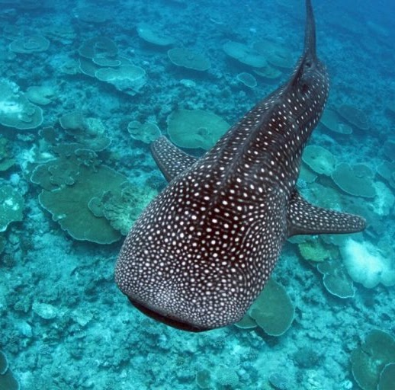

MSP Tools
© WWF-TZ
December 2021

Slide 2
Contents
Introduction
Process
Tools
‹#›
© WWFTZ
Notes:
foward

Slide 3
Introduction
© WWFTZ

Slide 4
Process
i. Defining
ii. Developing
iii. Accessing
iv. Implementation
v. Follow-up
© WWFTZ
Notes:
General steps:
Identify need and establish authority
Obtain ﬁnancial support
Organise the planning process
Organise stakeholder participation
Deﬁne and analyse existing conditions
Deﬁne and analyse future conditions
Prepare and approve a marine plan
Implement and enforce a marine plan
Monitor and evaluate performance of a plan
Revise and adapt a marine plan.
Source: https://seymsp.com/the-initiative/methodology/

Slide 5
Tools based on Process
Defining
© WWFTZ

Slide 6
Tools based on Process
2. Developing
© WWFTZ

Slide 7
Tools based on Process
3. Assessing
© WWFTZ

Slide 8
Tools based on Process
4. Implementation
© WWFTZ

Slide 9
Tools based on Process
5. Follow-up
© WWFTZ

